Slide 1
Digital Portfolio
STUDENT NAME:BABYSHALINI.G
REGISTER NO AND NMID: astvu36336324u18003/
AFE9A060A8FD3CB933348D07D5566CA9
DEPARTMENT:BSC(COMPUTER SCIENCE)
COLLEGE: SREE ABIRAAMI ARTS AND SCIENCE COLLEGE FOR WOMEN /THIRUVALLUVAR UNIVESITY

Slide 2
Project title
DIGITAL PORTFOLIO IN FRONTEND DEVELOPMENT

Slide 3
AGENDA
Problem Statement
Project Overview
End Users
Tools and Technologies
Portfolio design and Layout
Features and Functionality
Results and Screenshots
Conclusion
Github Link

Slide 4

PROBLEM STATEMENT In the modern digital age, having a strong online presence is essential for showcasing skills and attracting potential employers or clients. Many developers struggle to present their work effectively. This project aims to solve that problem by creating a personal frontend portfolio website that is responsive, visually appealing, and informative.

Slide 5

PROJECT OVERVIEW The objective of this project is to design and develop a responsive, interactive, and professional portfolio website that highlights frontend development skills, showcases projects, and provides contact details for networking opportunities. The site is built using modern frontend technologies with a focus on performance, accessibility, and user experience.

Slide 6

WHO ARE THE END USERS? Recruiters: To evaluate skills, experience, and projects. Clients: Looking for frontend developers for freelance or full-time projects. Fellow Developers: For collaboration and networking. Personal Branding: Anyone searching for the developer online.

Slide 7

TOOLS AND TECHNIQUES HTML5 & CSS3: For structure and styling. JavaScript (ES6+): For interactivity and logic. React.js (Optional): For building reusable UI components. Tailwind CSS / Bootstrap / SCSS: For faster styling and responsiveness. Git & GitHub: Version control and deployment. Figma / Adobe XD: For UI/UX design planning. Netlify / Vercel / GitHub Pages: For live deployment.

Slide 8
POTFOLIO DESIGN AND LAYOUT
Hero Section: Introduction and professional title.
About Me: Brief description, skills, and technologies.
Projects: Interactive cards or sections displaying major projects with GitHub/demo links.
Resume: Downloadable or viewable online.
Contact Section: Contact form and social media links.
Footer: Copyright and quick links.
8

Slide 9
FEATURES AND FUNCTIONALITY
Responsive Design: Fully functional on mobile, tablet, and desktop devices.
Dark/Light Mode (Optional): Toggle between themes.
Smooth Scrolling & Animations: For better UX.
Interactive Project Cards: Hover effects, modals, or image sliders.
Contact Form: Sends messages using EmailJS or Formspree.
Live Preview Links: Deployed versions of featured projects.
Accessibility Features: Keyboard navigation, ARIA labels, and alt text.
F

Slide 10
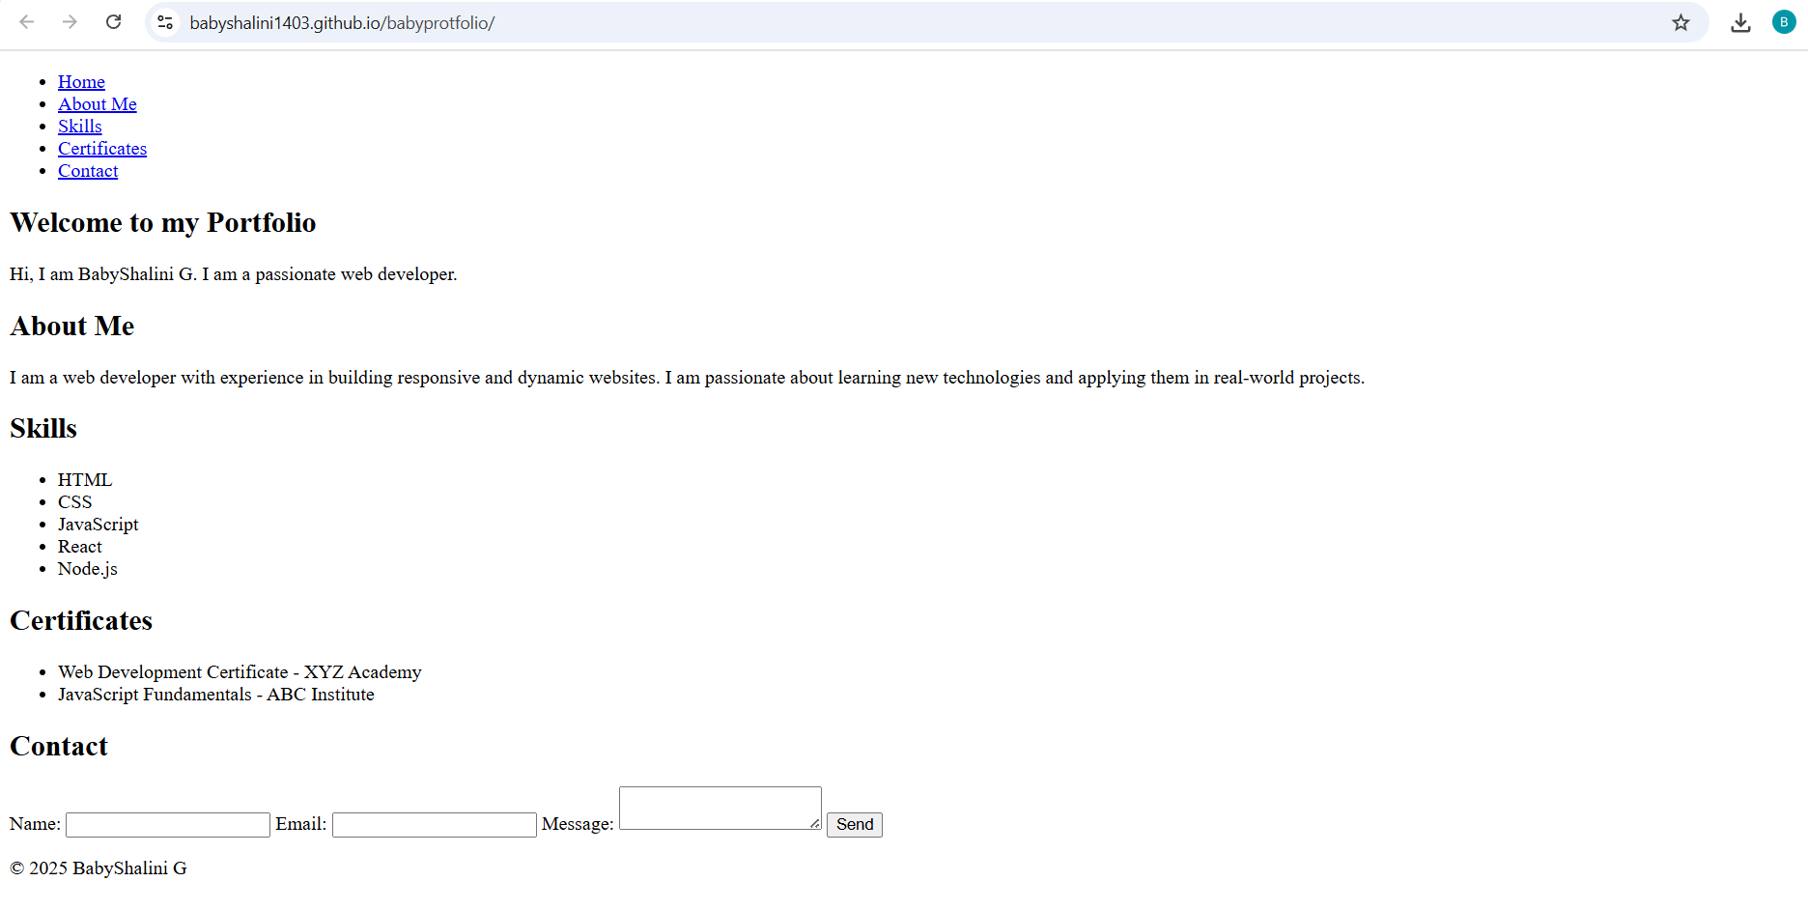

RESULTS AND SCREENSHOTS
3/21/2024 Annual Review
10

Slide 11
CONCLUSION
This portfolio project serves as a personal branding tool and a live showcase of frontend development capabilities. It combines modern design trends with technical skills to leave a lasting impression on visitors. It is a continuous work in progress, regularly updated with new projects, blogs, or skill updates.
11

Slide 12
GITHUB LINK
GITHUB LINK
babyportfolio

